Slide 1

DriverPass System Analysis
Cristian Alvarez
Notes:
[No speaker notes required for this slide.]

Slide 2

System Requirements
The proposed system will allow users to create, remove, modify and view reservations
The system will use a website for users to provide inputs , with a database for storing information
The system will allow instructors to provide feedback and administer driving tests
The system will allow customers to take online tests
The system will be work with mobile and desktop.
Notes:
We understood that this system will help provide a service to customers, in the form online driving courses and in person driving tests with an instructor, after driving tests instructors can provide feedback to users which can be seen from the website. From the conversations had with Liam we know this must be accessible from anywhere and be online with a high degree of reliability. The system will use a service to provide a server for the website and database, so the upfront cost for local server will be minimal to zero.

Slide 3
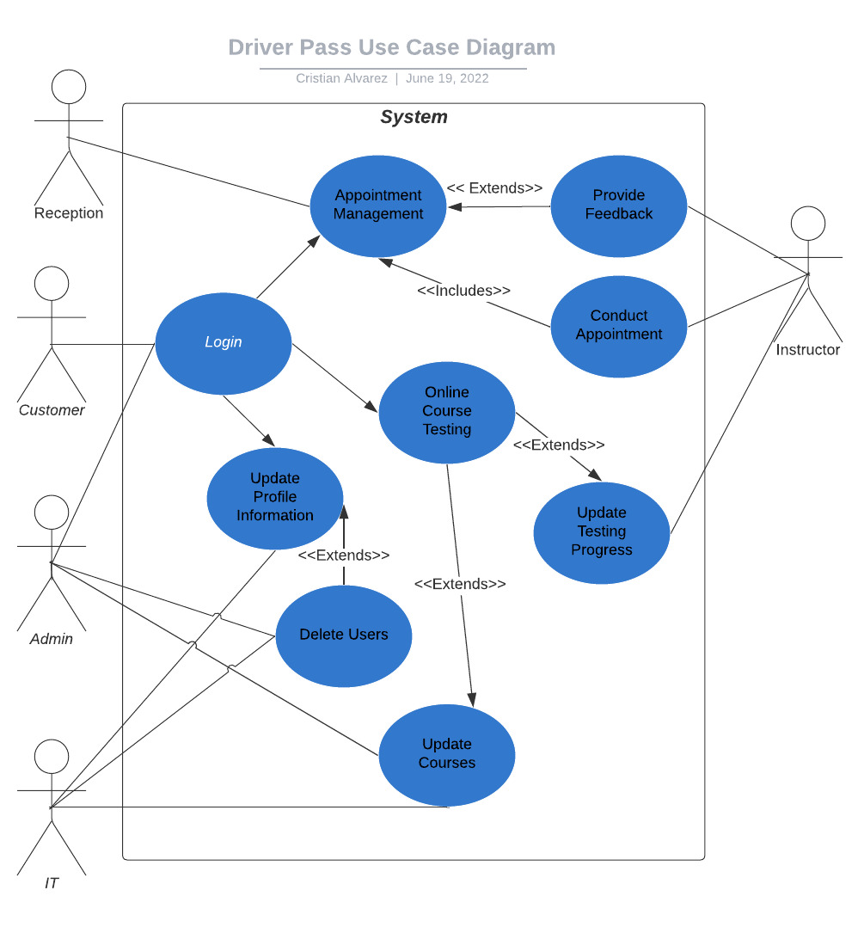
Use Case Diagram
[Insert your use case diagram here.]
Notes:
An actor is someone who uses the system, that can be customer or employees. The system will allow customers, to update their personal information, manage appointments and do online tests. While the rest of the uses for the system will be employees. IT can update courses and delete users; Admins like Liam will be able to Delete Users and Update Courses. Instructors will be able to Conduct appointments and provide feedback to users and update Testing progess. Finally, the receptionist(s) will be able to manage appointments.

Slide 4
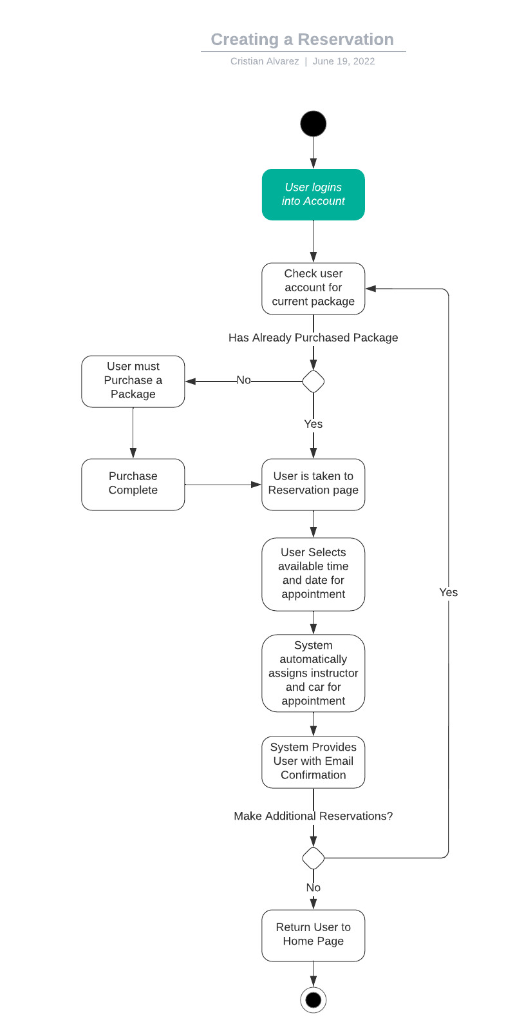
Activity Diagram
Notes:
This diagram shows the flow of processes for creating a reservation from the user's perspective. The process begins with the user logging in, the system will check if the user has an packages purchased, if they don’t then it will redirect them to the store, if they do then the reservation overview page is displayed, and the user can then begin to schedule an appointment. Once the user selects time and date the System will check if the specified timeslot is available and if it is then an instructor and car will be automatically assigned to that reservation based on availability. Finally, the system generates an Email confirmation with details for their records and review, and the system returns the user to the homepage.

Slide 5
Security
Implementation of username/email and password to login.
The system will be a client and server model.
All users will have roles dictating what they can access
2 factor authentication is required for all employees (Password and then one-time code)
The system will log changes to the system, with time and user stamps.
Users will be able to reset passwords through their email address
Notes:
[How did you consider security in your design? In your explanation, keep your audience in mind by avoiding the u se of technical terms.] The security of the system is very important, since we will be storing personal and payment information for users making sure the no unintended users can access secure parts of the system is critical. All employees will be required to provide an email address so any daily login attempts will require them to authenticate who they are so if employee data is stolen or misplaced then unintended persons cannot log into those accounts. Admins will be able to disable and delete any user accounts to prevent outlining user profiles. The system checks user roles at login to make sure the correct pages will be displayed to them. Finally, users will only be able to make requests to the server and the server will check if they have the correct role and permission to make that request and will either except or deny that request and then log the activity for the admins to review whenever.

Slide 6
System Limitations
The number of users interacting with the system at the same time will affect the performance of the system
Payment Processing will have to be purchased or added to the system from a third-party company
Compliance to change DMV laws will require manual review. An automated system will be unable to change courses.
An internal employee will need to be hired to ensure the service continues to run smoothly
System will always be online
Notes:
The more users that interact with the system at the same time will put strain on the system and will require monitoring to ensure the correct number of resources are being paid for while also making sure the system is performing as expected. The system will be unable to process payments on its own and will require a third-party solution that is integrated into the system or outsourced. As of right now it doesn’t look like the DMV has a system in place to send information to users regarding compliance and regulation changes. An employee will have to manually review the changes and then make any applicable changes to courses. An IT admin will be needed to make sure the system stay online; the system always requires an internet connection so if the server service provider goes down for maintenance or unexpected outage occurs then the system will be down until it has been resolved. Having a local backup for that can still provide payment services and course catalog could help prevent revenue from being lost in the case of an outage.

